Slide 1
Twitter Sentiment Analysis

Slide 2
What is Sentiment?
The process of computationally identifying and categorizing opinions expressed in a piece of text, especially in order to determine whether the writer's attitude towards a particular topic, product, etc. is positive, negative, or neutral

Slide 3
What is Twitter Sentiment Analysis?
Twitter sentiment analysis is a process of using natural language processing, machine learning, and data analysis techniques to determine and extract the sentiment expressed in tweets on the social media platform Twitter.

Slide 4
Objective Of the Project
Sentiment Classification
Real-time data retrieval
Data Preprocessing
Feature Engineering
Model training and evaluation
To create function that immediately classifies a twit to sentiment
Visualizations and Reporting

Slide 5
Workflow
Get data from Kaggle.
Performing EDA
Creating Different ML models for further analysis.
Model Accuracy Comparison
Creating Power BI dashboard for Vosualization

Slide 6
libraries are used for Tweeter sentiment Analysis project
Tweepy
Pandas
NumPy
NLTK (Natural Language Toolkit)
Matplotlib and Seaborn

Slide 7
Machine Learning Algorithms:
Logistic Rregression
Naïve Bayes
Bernoulli Naïve Bayes
Multinomial Naïve Bayes
Hybrid

Slide 8
EDA - Exploratory Data Analysis/ Data Preprocessing
1. Data Loading and Overview
2. Handeling Missing Values
3. Imabalance Detection
4. Sentiment Analysis Visualisation
5. Stemming
6. Data Separation for Analysis

Slide 9
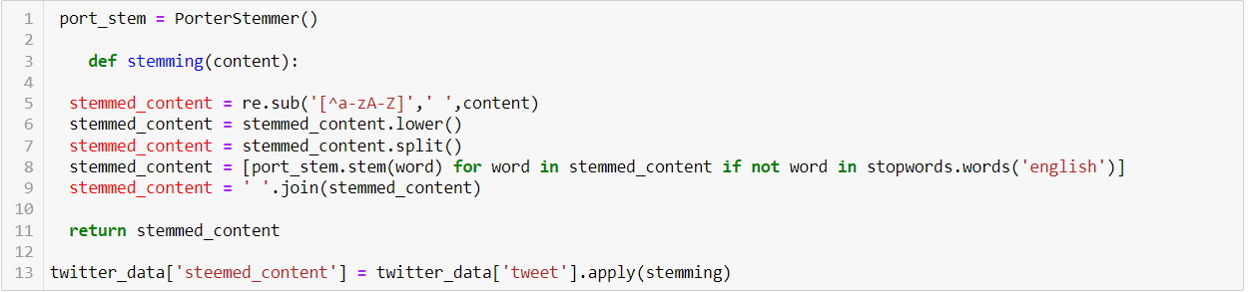

Slide 10
Logistic Regression
Logistic regression is a statistical method used for binary classification problems, where the outcome variable is categorical and has two possible classes.
The logistic regression model uses the logistic function to model the probability that a given input belongs to a particular class.
The logistic function ensures that the output of the model is between 0 and 1, making it suitable for representing probabilities.
The logistic function is defined as:
σ(z)=1+e−z1​

Slide 11
Naïve Bayes
Naïve Bayes is a probabilistic machine learning algorithm based on Bayes' theorem. It is primarily used for classification tasks, especially in natural language processing and text classification.
The formula is as follows:
P(A∣B)=P(B)P(B∣A)⋅P(A)​

Slide 12
Multinomial Naïve Bayes
Multinomial Naïve Bayes is another variant of the Naïve Bayes algorithm, designed for classification tasks where the features represent the frequencies with which certain events occur.
It is particularly suitable for discrete data, often used in text classification, document classification, and other applications where the input features can be counts, such as the number of times a word appears in a document.
The formula is as follows:
P(A|B) = P(A) * P(B|A)/P(B)

Slide 13
Bernoulli Naïve Bayes
Bernoulli Naïve Bayes is a variant of the Naïve Bayes algorithm, particularly suitable for binary feature vectors.
It is based on the Bernoulli distribution and is used when features are independent booleans describing inputs.
The formula is as follows:
P(A|B) = P(B|A) * P(A) / P(B)

Slide 14
Hybrid Model
A hybrid model refers to a combination of two or more different models or techniques to address a particular problem or task.
Hybrid models are commonly used in various fields, including machine learning, where combining different algorithms or approaches can lead to improved results compared to using a single model.
The formula for a hybrid model can vary widely depending on the specific combination of models or techniques being used. In general, the formula for a hybrid model involves a combination or ensemble of multiple models, often weighted or combined in some way.
Here's a generic representation:
w1​⋅Model1​(Input)+w2​⋅Model2​(Input)+…+wn​⋅Modeln​(Input)

Slide 15
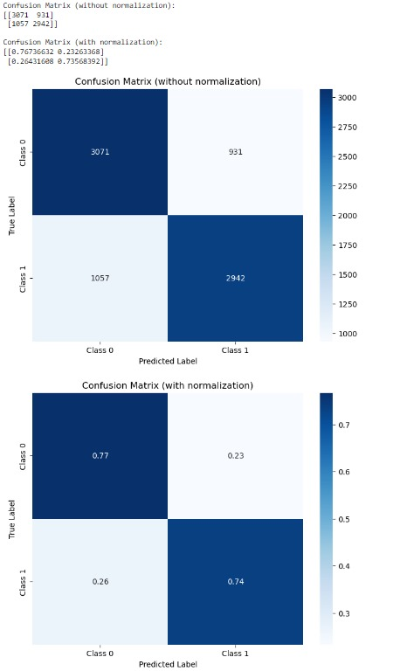

Slide 16
Conclusion
Summarize the overall contributions and significance of the sentiment analysis project.
Emphasize the importance of sentiment analysis in understanding public opinion and its applications in various domains.

Slide 17
Thank You

